Slide 1

Leaders Course
A One-Day Introduction to Squash Leadership

Slide 2
Why is Squash a good sport for clubs and schools?
Squash is a great school and club sport because
it is:
Played by both boys and girls
Suitable for all ages and levels of ability
Fun in a short time
Low impact sport for children
Can be played at all ages, by all abilities, a game for life

Slide 3

Squash develops all round physical skills important for school age children including:

Slide 4
Squash develops all round physical skills important for school age children including:
Hand eye co-ordination
Catching and throwing
Stability and balance
Speed and agility – the ability to change direction quickly
Decision making
Tactical thinking

Slide 5


Before you start, think of:
Coaching facility – Number of courts, size and wall area of school hall/sports centre
Is the facility safe? – Risk Assessment
Emergency and fire evacuation procedures
Who to call in an emergency
Who you are going to coach? - ability, age, special requirements, number of players
Emergency contact numbers and medical information
First Aid Provision
Equipment required? – rackets, balls, eye protection

Slide 6
Attributes of the Leader
Teacher
Manager
Psychologist
Motivator
Advisor
Role Model

Slide 7

The need for safety!
All junior players to wear appropriate eye protection
Discipline – players must STOP immediately when asked
Surface is appropriate and free from obstruction
Keep loose squash balls in a container
Enough space for each player/group
Ensure players are wearing appropriate clothing and footwear. Jewellery should be removed
Introduce the concept of a LET as soon as possible
Do not let anyone enter a squash court without warning
Encourage balls to be retrieved with care

Slide 8
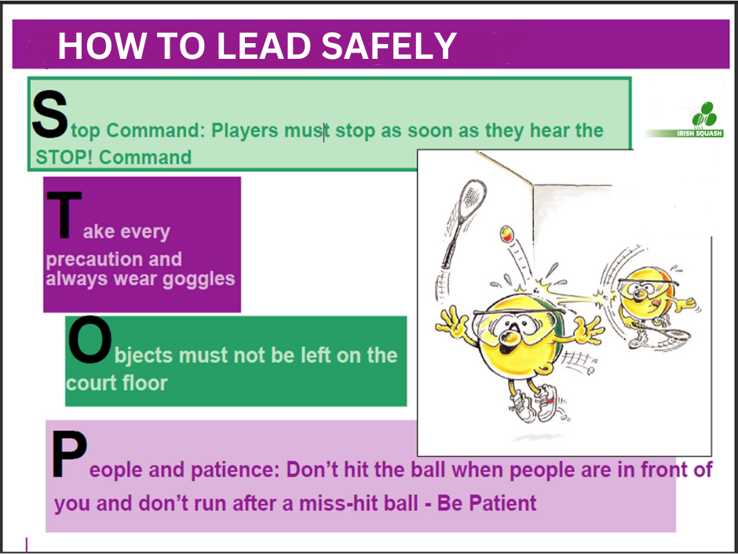

Slide 9
How to lead

Slide 10
Leadership Styles
Coach led, participant led, individual and group work
Set Up and Stand Back – knowing when to let players learn through doing and discovery without leadership intervention
Show and Tell – demonstrate & explain
Ask and Think – the leader asks questions to encourage thinking and problem solving

Slide 11
Delivering a Session
It is common to use the IDEAS principle:
I
Introduce, say what you are going to show
D
Demonstrate the activity
E
Explain the activity – KEY POINTS
A
S
Activity to practise the skill and for the coach to observe and correct players
Summarise with your group at the end to ascertain that the players have understood the activity and for feedback

Slide 12
Demonstrations
AIM : to create a clear image of the shot
The leader/coach
Use of a video
Shadow
Photograph
Another player

Slide 13
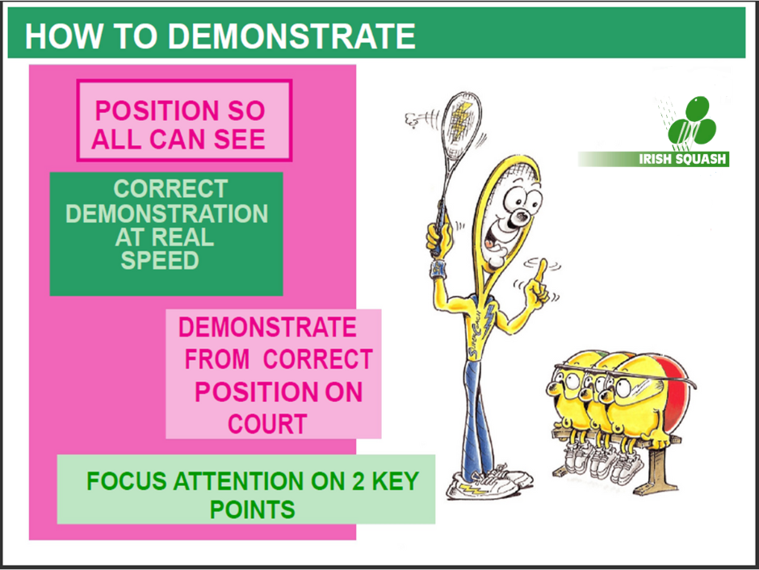

Slide 14

Feeding
What is feeding?
      Supplying a player with a ball to practice a particular shot/ technique
      It can make the practice easier or more difficult
Types of feeding
      Self - hand or racket
      Self - the player throws or drops the ball to set up the shot
      Hand – single and multi ball
      Racket – single and multi-ball
      Partner drills
      Targets should be set for both the hitter and the feeder

Slide 15
What to teach?

Slide 16
Key Points
Grip
Footwork
Racket / arm action
Point of impact
Follow through

Slide 17
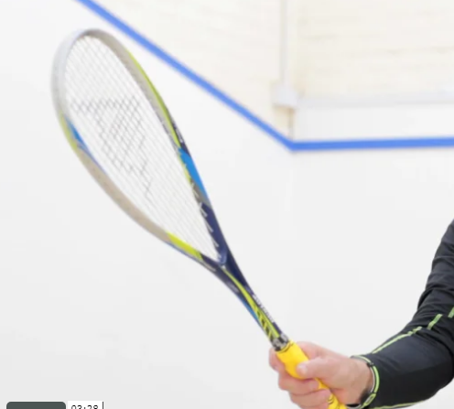
Grip – What, Why, When & How
WHAT – controls the angle & direction of the racket head
WHY – it determines the height, direction, length, width, speed & touch of the ball
WHEN – all the time
HOW – shake hands grip

Slide 18
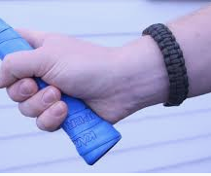
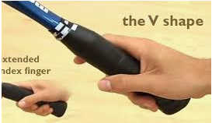
The Grip
The basic grip should be the same for both forehand and backhand
The grip should look like picture 1
  the racquet is held by 3 fingers , your thumb , and your index finger
Picture 2 shows the V shape created by the Thumb and index finger, gives you an open shape to your racquet.

Slide 19
Teaching Sequence
The game of squash is relatively simple so try to get your players playing a game as soon as possible. They will get more enjoyment this way and we hope will want to play more.
It is not necessary to know all the shots before playing a game. Drives, service and return of service and scoring are all that are necessary and this possibly can be achieved after a few lessons.
A logical teaching sequence would be:
Drives – forehand, backhand and x-court
Serve and return of serve
Scoring and some rules
Volley
Boast or sidewall shot
Lob
Drop
The speed of progression with these shots depends on age and ability

Slide 20
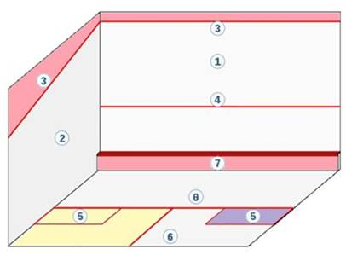
The Court
OUT
LINE
FRONT WALL
SQUASH SERVICE LINE
SIDE WALL
THE “TIN”
SERVICE
BOX
BACK
WALL
HALF COURT LINE
SHORT
LINE

Slide 21
SQUASH SHOTS – What, Why, When, How
Drive
What – to hit a FH and BH drive to target. Close to the side wall and behind the service box so that the ball fades in to the back corner
Why – so it is difficult for your opponent to return
When – the drive is a building shot in a rally. It forces your opponent into the back corners so that you can control the T zone.
How – Correct grip, move from the T zone. Early racket preparation . Maintain rhythm and balance , transfer body weight through the ball. Follow through in intended path of ball and move back to the T zone

Slide 22
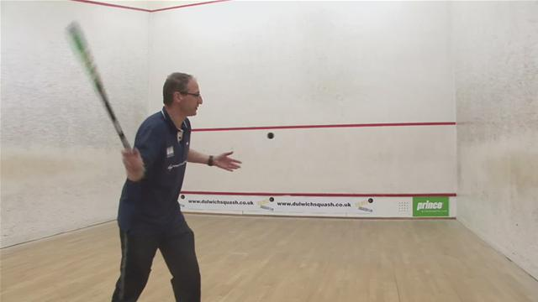
Volley
What – to hit FH and BH volley to target. Close to the side wall and behind the service box so that the ball fades into the back corner
Why – takes time away from your opponent and enables you to gain control of the T zone
When – return of service and as often as possible
How – Same as drive ,but take the ball in line with the non-playing shoulder on FH and in line with the playing shoulder for BH. Open the racket face and release the racket in a punching action.

Slide 23
Service
What – to serve to target. Hit the ball on to the front wall and then to hit side wall before dropping behind the service box.
Why – to put pressure on opponent at the start of the rally
When – to start the rally
How – at least one foot in the service box when you strike the ball

Slide 24
Return of Service
What – to return the serve with a straight drive or volley to target. Close to the wall and behind the service box so that the ball fades in to the back corner
Why – to move your opponent off the T zone and make it difficult for them to return
When – if appropriate try to volley the return to take time away from your opponent
How – as drive or volley

Slide 25
Boast (or Sidewall Shot)
What – to hit a FH and BH boast. The ball should strike the side wall first , then the front wall.
Why – attacking or defensive shot. Draws your opponent into the front corner of the court and provides recovery time.
When – attacking boast is played when your opponent is behind you. Defensive is played from the back of the court when you have no other option.
How – same as drive but body is turned slightly more towards the back corner. Drive the ball in to the sidewall .Use your follow through to transfer your body weight and begin your movement back to the T .

Slide 26
Drop
What – to hit a FH and BH drop to target.
Why – The drop shot moves your opponent into the front of the court and away from the T zone
When – your opponent is in the back corners ,off balance ,not looking or when opponent is tiring
Acton – similar to the drive, but get down low to the ball and strike the ball in front of your leading leg. Racket preparation is low, with a slow swing and gentle follow through

Slide 27
Lob
What – to hit a BH and FH lob to target. The ball should be struck high, slow and wide to fade in to the back corners
Why – to provide you with time to recover, change the pace of the game and to upset the rhythm of the opponent
When – your opponent is in the front of the court or moving forward or when you need time to recover
How – similar to the drive , but get down low and underneath the ball and lift the ball. Strike the ball in front of your leading leg. Use an open racket face and swing through with a high follow through.

Slide 28
Evaluating your Session
After each session you should go back and review it i.e. how well did it go? The session should be reviewed under the following headings :
Goals
Did you achieve your goals?
Active
Were the players engaged physically?
Variety
Did the session have different learning styles?
Interest
Did the session hold the players attention?
Was it FUN?!

Slide 29
Competition

Slide 30
A Ladder
A ladder is
An order of merit
A tool to engage players and club members after the introductory programme
A tournament can be run to establish the initial ladder order
Sample ladder on next slide

Slide 31
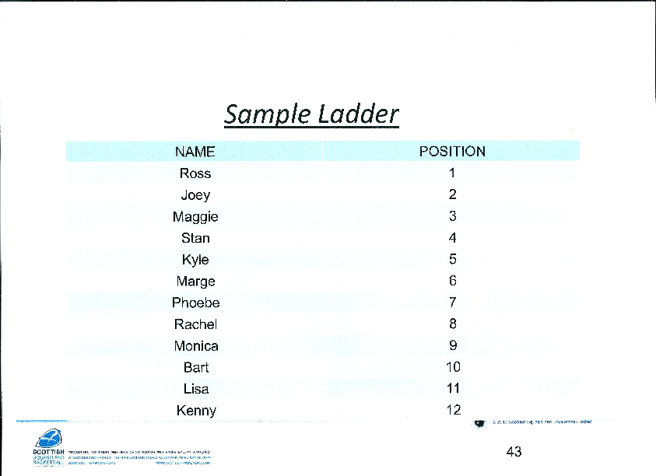

Slide 32
Sample Ladder Rules
Choose a scoring system e.g. one game to 11 points, using point-a –rally (PAR) scoring
Only the leader/coach can change the ladder positions.
A player must accept a challenge from below before they can make another challenge above.
Players can score (mark) and referee challenge matches and develop their understanding of the rules of squash.
A ladder can allow open challenges for a month and then challenges can be restricted to 2 places above.

Slide 33
Round Robin Tournament
In a Round Robin tournament players are organised into groups. Each player plays every other player in the group.
The winners of each group can then play the other winners to get an overall winner.
It is a great way to give players lots of games and to play people they have not played before.
A disadvantage is that it takes quite a lot of time to play.
Group of 4 - 6 matches
Group of 5 - 10 matches
Group of 6 - 15 matches
The next slide shows templates for groups of 4 , 5 or 6 players in a Round Robin format.

Slide 34
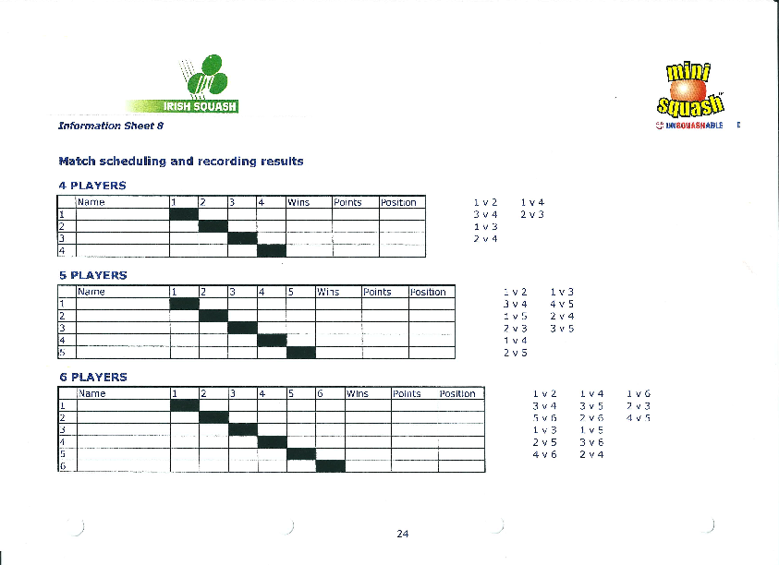

Slide 35
Box Leagues
A box league uses the same structure as the Round Robin tournament
The players are divided into groups of 4 or 5 . Each person plays every other person in the group.
Players arrange their own matches and are given a time frame – suggest 2, 3 or 4 weeks to complete the matches.
At the end of this time scores are collated and the top player of the box moves up to the next box. The bottom player moves down and the competitive games begin again with a different group of players.
This is a great way of getting players in a club to mix ,socialise and play people that they have not played before. It allows people to find their playing standard within a club.
This system lends itself well to online administration.

Slide 36
Swiss Format Tournament
This format works well for a group of 8 or 16 competitors. Everybody plays 4 matches.
At the end players get a ranking between 1 and 8 or between 1 and 16.
It is used a lot in tournaments in Ireland and for one – day competitions.
A draw for an 8- player Swiss format tournament is shown on the next slide.

Slide 37
Swiss Format Draw
THE WINNER OF EACH MATCH TAKES THE LOWER NUMBER TO THE NEXT ROUND - THE LOSER TAKES THE HIGHEST NUMBER
Round 1 |  | Round 2 |  | Final Play-Offs |  | Final Position
1 |  | 1 |  | 1 |  | 1
8 |  | 4 |  | 2 |  | 2
2 |  | 2 |  | 3 |  | 3
7 |  | 3 |  | 4 |  | 4
3 |  | 5 |  | 5 |  | 5
6 |  | 8 |  | 6 |  | 6
4 |  | 6 |  | 7 |  | 7
5 |  | 7 |  | 8 |  | 8

Slide 38
Knockout Tournament
Knockout tournaments are not used so much now. This format is mainly used in Open and National tournaments.
When used it is usual to have a plate competition for 1st Round losers and also a plate competition for 2nd Round losers. This means that each competitor will have at least 3 matches.

Slide 39
USEFUL WEBSITES &LINKS
Squash Wales – Physical Literacy: https://youtu.be/R8PIXqp3JpA
Irish Squash: http://www.irishsquash.com/contact-us
http://www.squashplayer.co.uk/
www.ulstersquash.com/
http://www.sportscoachuk.org/coachinsurance
"England Squash & Racketball“ news@englandsquashandracketball-news.com
http://www.englandsquashandracketball.com/system/files/2099/original/The_Court_Challenge_Series_-_Competition_Organisers_Guide.pdf
http://www.squashezine.com/
"Ashley Kayler" ashley@insidesquash.com
http://www.insidesquash.com/lessons/basic-tactics.html
http://squashskills.com/videos/courses/beginners#

Slide 40
Acknowlegements
Many thanks to the following who have helped and supported with the format, content and delivery of this coaching course
Mervyn Fee – Coaching Ireland Badminton Tutor
Norman McGlinchey –Scottish Squash CDO
Dorothy Armstrong – Former Irish player, Irish Team coach and International referee
Ryan Prentice – Ulster Badminton CDO
Kieran Doherty –Coaching Ireland Squash Tutor

